Slide 1

Species Distribution Models: Data and Algorithms
The Wallace team
Slide deck lead by Andrea Paz and Jamie Kass

Slide 2
Part 1: Data

Slide 3










Biodiversity data
Species Presences
General databases
Taxon-specific databases
Country and region specific databases (only recommended as complementary data or for endemics)
Expert information: field notes and/or non-public collection data
https://bien.nceas.ucsb.edu/bien/
http://www.herpnet.org/
https://sibcolombia.net
https://www.gbif.org
vertnet.org
https://bison.usgs.gov/

Slide 4
Biodiversity data
Data quality
Is the species correctly identified?
Are coordinates provided? Is uncertainty provided?
Is there a detailed description of the locality?
Looking at the map, are they in the correct area, ecosystem, geographic region?
Are coordinates from a GPS or where they georeferenced? What is the error? Does it matter?

Slide 5

Biodiversity data
Species Absences
How would this look?

Slide 6
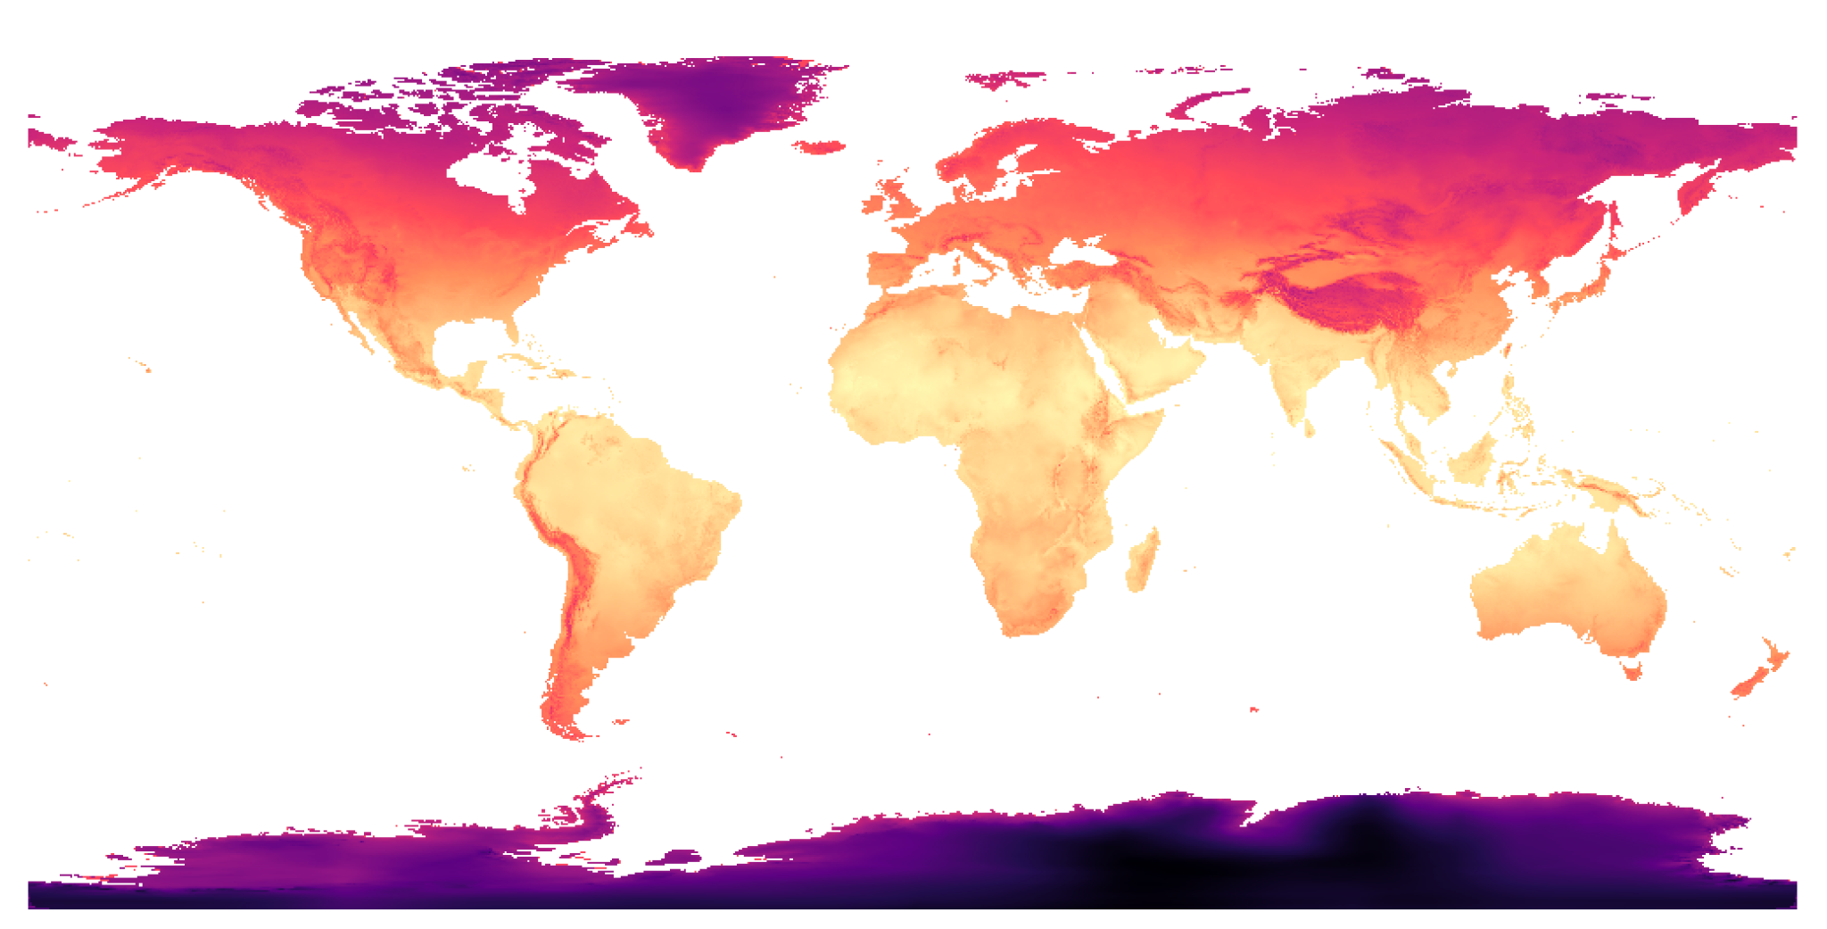


Abiotic data
Some examples
global representation of bioclim01
Pre-calculated bioclimatic data (19 & more)
Worldclim: http://www.worldclim.org/
Chelsa: https://chelsa-climate.org/bioclim/
Ecoclimate: https://www.ecoclimate.org/downloads/
TerraClimate: http://www.climatologylab.org/terraclimate.html
Remote sensing: https://vdeblauwe.wordpress.com/
BIO1 = Annual Mean Temperature
BIO2 = Mean Diurnal Range (Mean of monthly (max temp - min temp))
BIO3 = Isothermality (BIO2/BIO7) (×100)
BIO4 = Temperature Seasonality (standard deviation ×100)
BIO5 = Max Temperature of Warmest Month
BIO6 = Min Temperature of Coldest Month
BIO7 = Temperature Annual Range (BIO5-BIO6)
BIO8 = Mean Temperature of Wettest Quarter
BIO9 = Mean Temperature of Driest Quarter
BIO10 = Mean Temperature of Warmest Quarter
BIO11 = Mean Temperature of Coldest Quarter
BIO12 = Annual Precipitation
BIO13 = Precipitation of Wettest Month
BIO14 = Precipitation of Driest Month
BIO15 = Precipitation Seasonality (Coefficient of Variation)
BIO16 = Precipitation of Wettest Quarter
BIO17 = Precipitation of Driest Quarter
BIO18 = Precipitation of Warmest Quarter
BIO19 = Precipitation of Coldest Quarter
Climatic data to process
From satellites (several sources but a compilation on Google Earth Engine): MODIS, CHIRPS etc
  Local agencies (Example: IDEAM)
Soil information
SoilGrids.org
Vegetation/Topography
Satellite based like NDVI & EDVI available on GEE (from MODIS, LANDSAT etc)
Others
EarthEnv: clouds, habitat, topography, freshwater etc.
Marine: Bio-Oracle, NOAA
Notes:
Image credit: Worldclim [open-access]

Slide 7
Abiotic data
Data quality
If you know the area: Do the variables make sense? (For example: what if you see a mean temperature of 30 degrees at 3000m/10000ft?)
If you do not know the area is there any available data for “ground truthing”? (local weather or land cover data for example)
If you have multiple datasets, are they all explaining different information?
For climate projections, GCM_compareR provides a good shiny app for comparison [https://github.com/marquetlab/GCM_compareR]

Slide 8


Abiotic data
How to pick?
Environmental predictor variables can be highly correlated
More or less problematic depending on algorithm and question
E.g., variable importance interpretation is affected by correlations
Some alternatives:
    Use algorithm tuning
    Use biologically relevant variables
    Reduce variable number with correlation analysis
Notes:
Image credit: Andrea Paz.

Slide 9
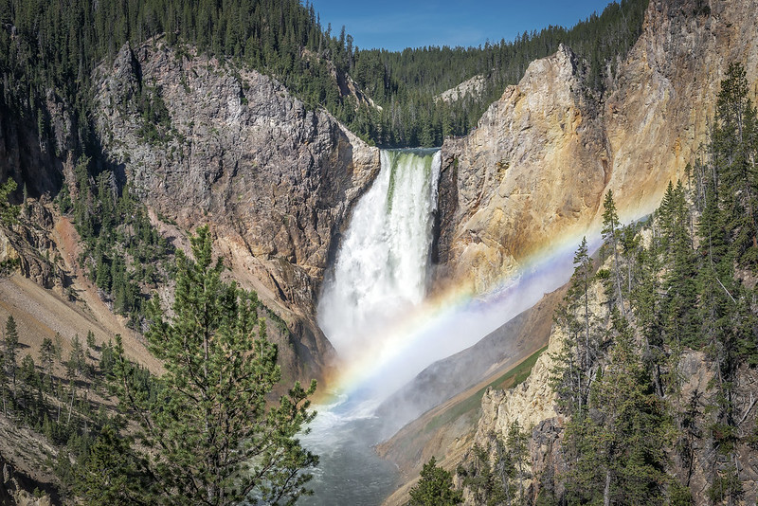
Abiotic data
How to pick?
If question related to changes in distribution under climate change (past or future):
    Layers for present must be available for the time model is projected
    In general, this limits us to climatic variables, BUT deforestation / land use models exist too
    Be careful with variables that do not change over time like elevation
Notes:
When planning on doing transfers in time there are some further constraints on the variables that can be used to select the model.
Image credit: Ken Lane/Flickr [CC BY-NC-SA 2.0 DEED]

Slide 10
Biotic data
What data could we have in the form of GIS layers?

Slide 11
Part 2: Algorithms

Slide 12
So many algorithms… is there a preferred one?
We can classify them in 5 categories:
      Presence only: BIOCLIM, DOMAIN, Mahalanobis distance

Slide 13
So many algorithms… is there a preferred one?
We can classify them in 5 categories:
      Presence only: BIOCLIM, DOMAIN, Mahalanobis distance
      Presence/Absence or Pseudoabsence: logistic regression models (GLM, GAM), Random Forest, Boosted Regression Trees, GARP

Slide 14
So many algorithms… is there a preferred one?
We can classify them in 5 categories:
      Presence only: BIOCLIM, DOMAIN, Mahalanobis distance
      Presence/Absence or Pseudoabsence: logistic regression models (GLM, GAM), Random Forest, Boosted Regression Trees, GARP
      Presence/Absence (repeat visit): occupancy models

Slide 15
So many algorithms… is there a preferred one?
We can classify them in 5 categories:
      Presence only: BIOCLIM, DOMAIN, Mahalanobis distance
      Presence/Absence or Pseudoabsence: logistic regression models (GLM, GAM), Random Forest, Boosted Regression Trees, GARP
      Presence/Absence (repeat visit): occupancy models
      Presence/Background: Maxent, Point Process Models

Slide 16
So many algorithms… is there a preferred one?
We can classify them in 5 categories:
      Presence only: BIOCLIM, DOMAIN, Mahalanobis distance
      Presence/Absence or Pseudoabsence: logistic regression models (GLM, GAM), Random Forest, Boosted Regression Trees, GARP
      Presence/Absence (repeat visit): occupancy models
      Presence/Background: Maxent, Point Process Models
      Model ensembles: multiple algorithms, or same algorithm with multiple settings

Slide 17
So many algorithms… is there a preferred one?
We can classify them in 5 categories:
      Presence only: BIOCLIM, DOMAIN, Mahalanobis distance
      Presence/Absence or Pseudoabsence: logistic regression models (GLM, GAM), Random Forest, Boosted Regression Trees, GARP
      Presence/Absence (repeat visit): occupancy models
      Presence/Background: Maxent, Point Process Models
      Model ensembles: multiple algorithms, or same algorithm with multiple settings
  Does the algorithm match the data? Are the ensembled models carefully chosen?

Slide 18
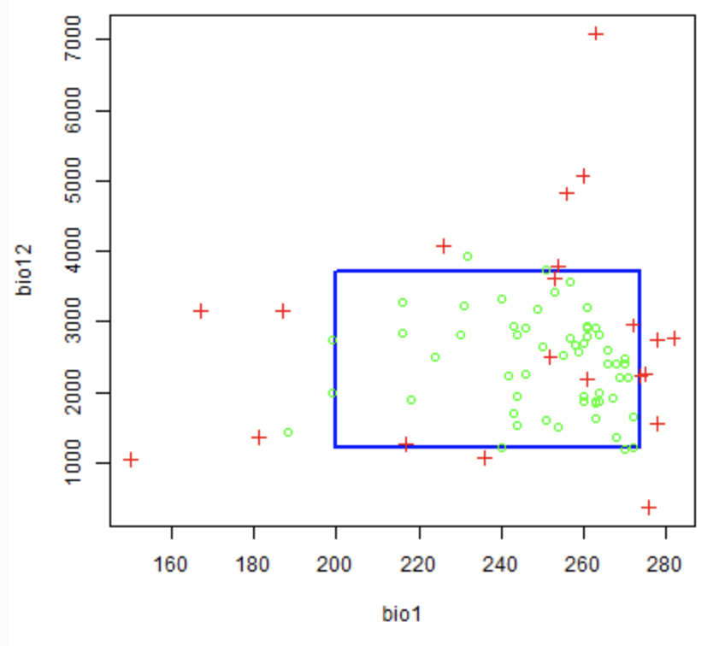
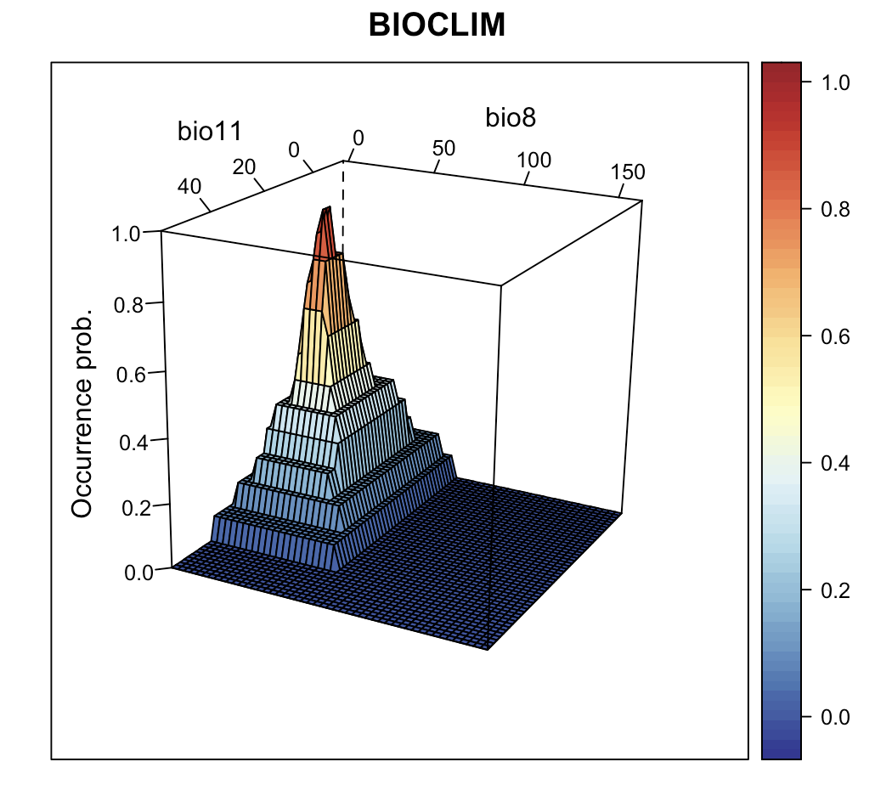
Presence only
BIOCLIM, HABITAT, DOMAIN, Mahalanobis distance
- Make predictions based on proximity to env. space of presences
https://rspatial.org/raster/sdm/6_sdm_methods.html#bioclim
https://damariszurell.github.io/EEC-MGC/b6_SDM_algorithms.html
Notes:
Image credits: Left: R.J. Hijmans and J. Elith. Species distribution modeling. Available from: https://rspatial.org/raster/sdm/index.html [CC BY-SA 4.0]. Right: D. Zurell. 2022. SDM algorithms. Available from: https://damariszurell.github.io/EEC-MGC/b6_SDM_algorithms.html [CC BY 4.0].

Slide 19
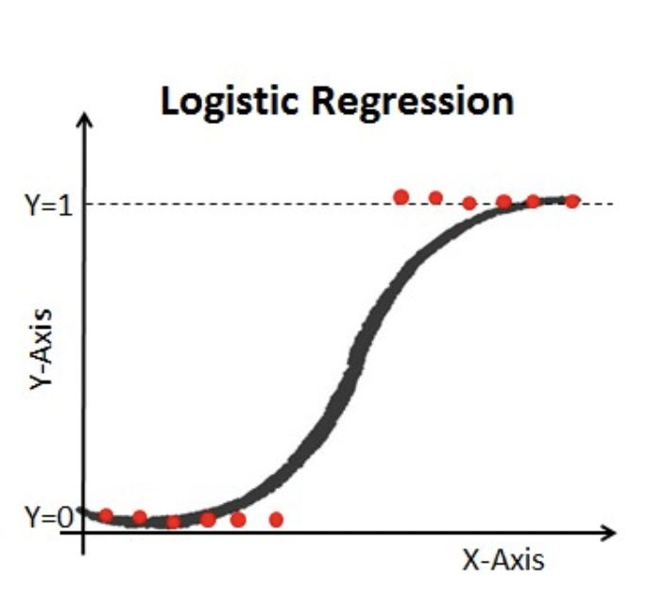
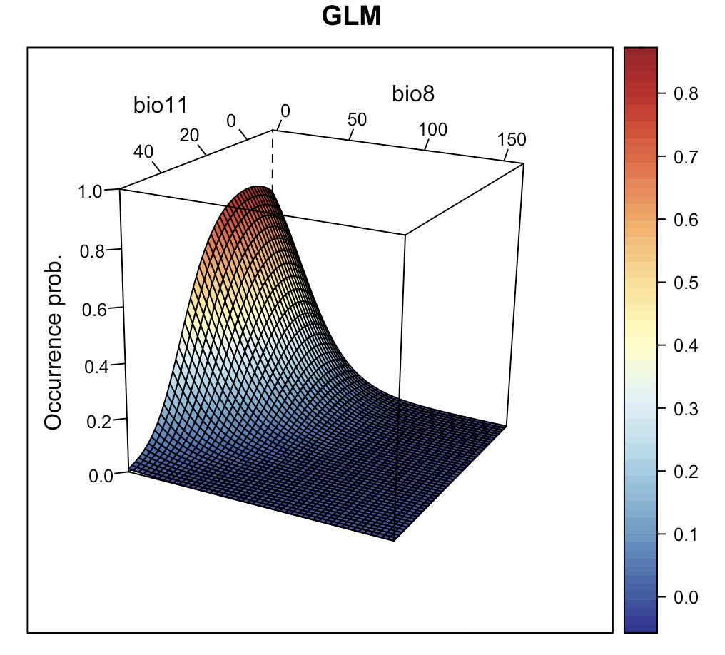
Presence/Absence or Presence/Pseudoabsence
Generalized linear models (GLM)
Logistic regression (binomial family)
Temperatura
https://damariszurell.github.io/EEC-MGC/b6_SDM_algorithms.html
Notes:
Image credits: D. Zurell. 2022. SDM algorithms. Available from: https://damariszurell.github.io/EEC-MGC/b6_SDM_algorithms.html [CC BY 4.0].

Slide 20
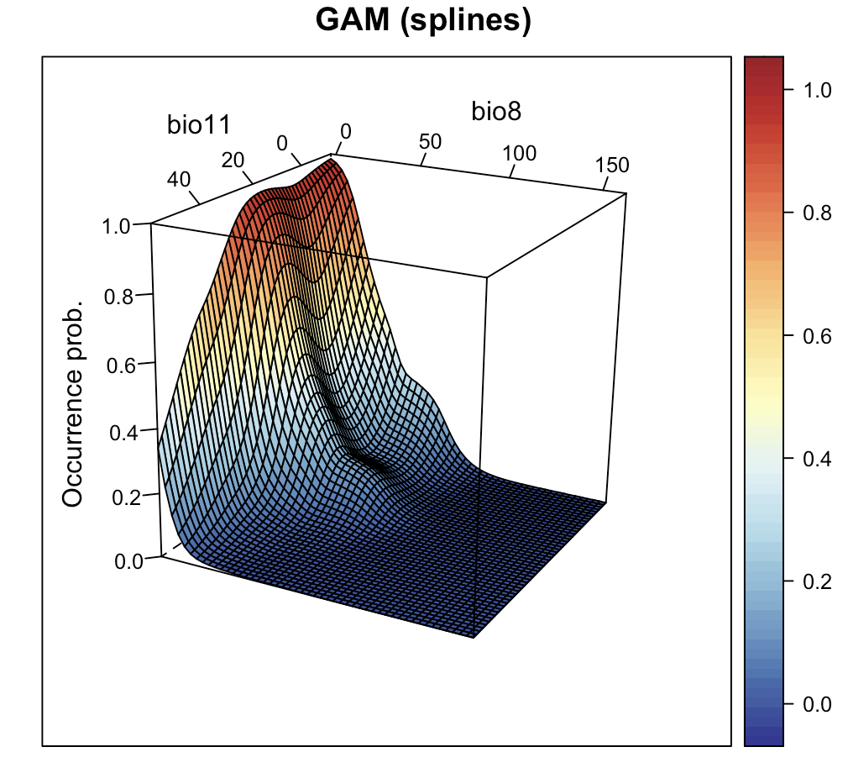
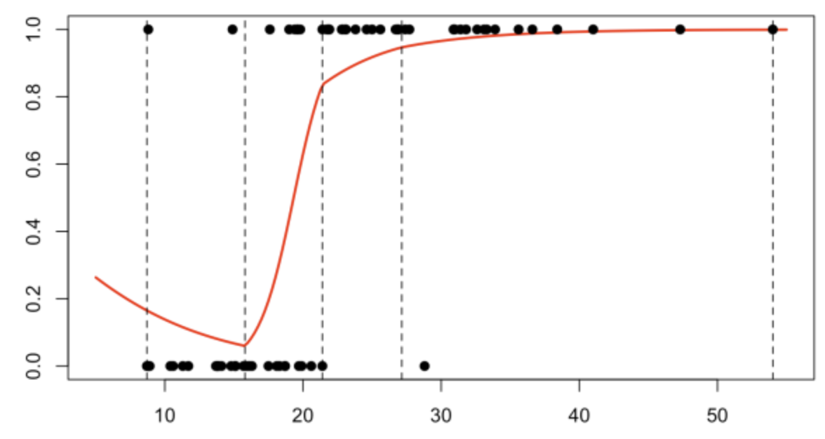
Presence/Absence or Presence/Pseudoabsence
Generalized additive models (GAM)
Logistic regression (binomial family)
Nonparametric splines
Temperatura
https://www.r-bloggers.com/2018/05/classification-from-scratch-logistic-with-splines-2-8/
https://damariszurell.github.io/EEC-MGC/b6_SDM_algorithms.html
Notes:
Image credit: D. Zurell. 2022. SDM algorithms. Available from: https://damariszurell.github.io/EEC-MGC/b6_SDM_algorithms.html [CC BY 4.0].

Slide 21
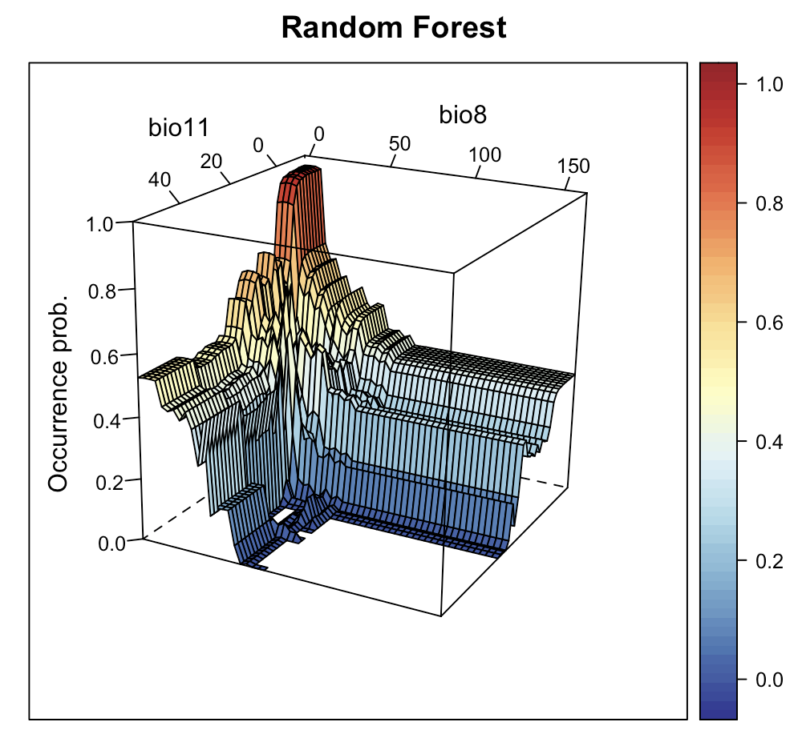
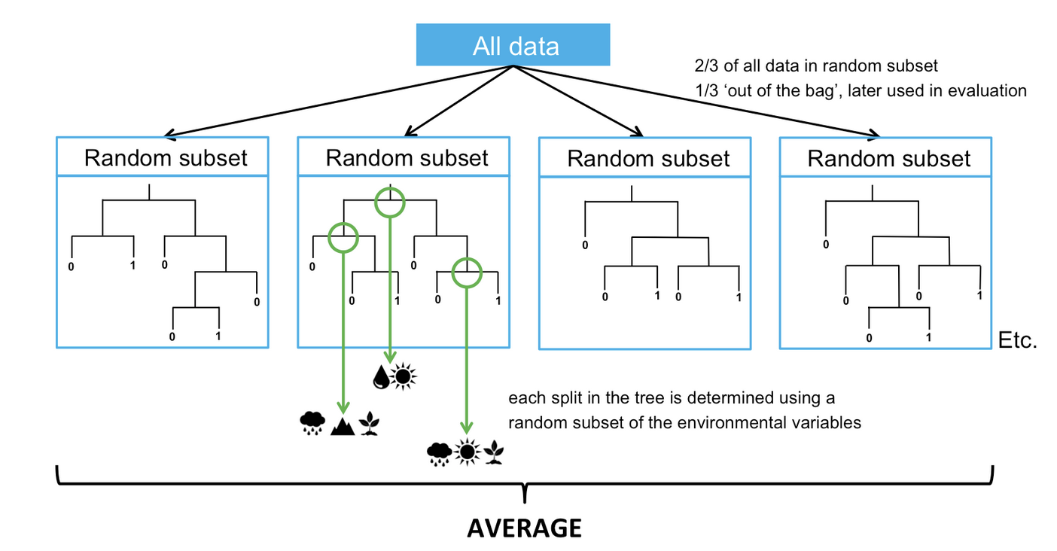
Presence/Absence or Presence/Pseudoabsence
Random Forests
Classification tree-based approach
Consensus prediction of many uncorrelated trees
Parameters: mtry: tree complexity
Temperatura
https://support.bccvl.org.au/support/solutions/articles/6000083217-random-forest
https://damariszurell.github.io/EEC-MGC/b6_SDM_algorithms.html
Notes:
Image credit: Left: Random Forest. 2021. Biodiversity and Climate Change Virtual Laboratory. Available from: https://support.bccvl.org.au/support/solutions/articles/6000083217-random-forest. Right: D. Zurell. 2022. SDM algorithms. Available from: https://damariszurell.github.io/EEC-MGC/b6_SDM_algorithms.html [CC BY 4.0].

Slide 22
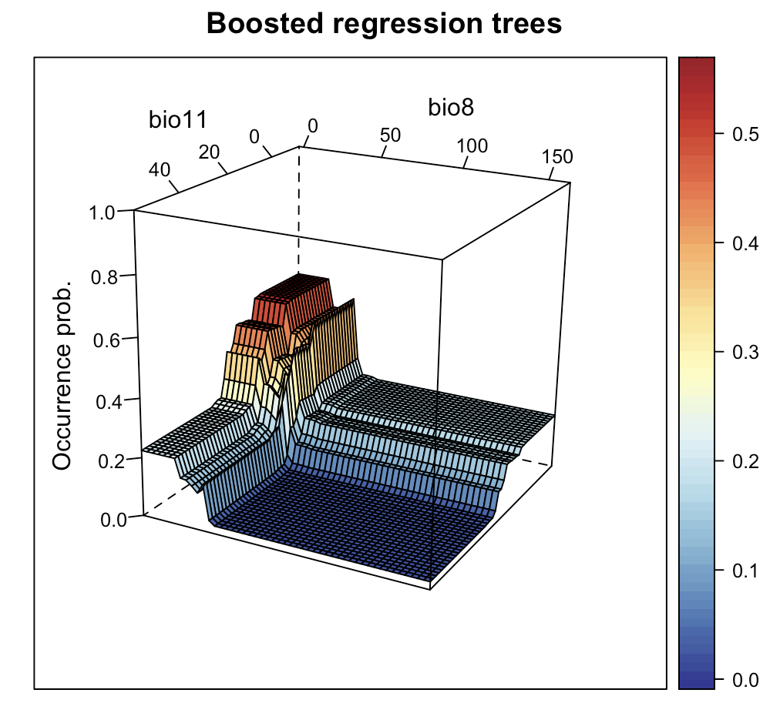
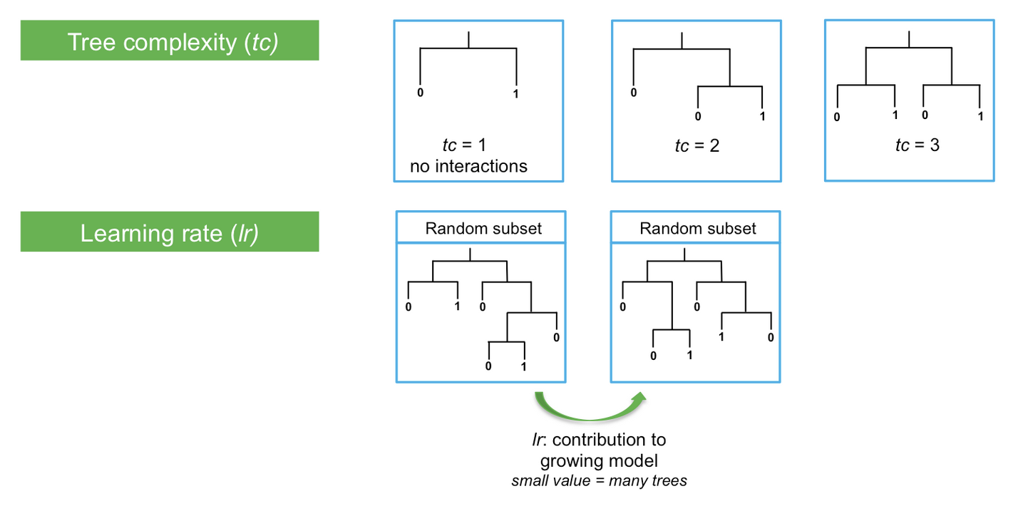
Presence/Absence or Presence/Pseudoabsence
Boosted Regression Trees
Classification tree-based approach
Linear combination of all trees (like regression)
Parameters: Learning rate, tree complexity
Temperatura
https://support.bccvl.org.au/support/solutions/articles/6000083217-random-forest
https://damariszurell.github.io/EEC-MGC/b6_SDM_algorithms.html
Notes:
Image credit: Left: Random Forest. 2021. Biodiversity and Climate Change Virtual Laboratory. Available from: https://support.bccvl.org.au/support/solutions/articles/6000083217-random-forest. Right: D. Zurell. 2022. SDM algorithms. Available from: https://damariszurell.github.io/EEC-MGC/b6_SDM_algorithms.html [CC BY 4.0].

Slide 23
Presence / Pseudoabsence
Pseudoabsences are sampled to emulate absences, so do not include presence points and not proximal to them
If species has poor sampling, hard to be confident about pseudoabsences

Slide 24
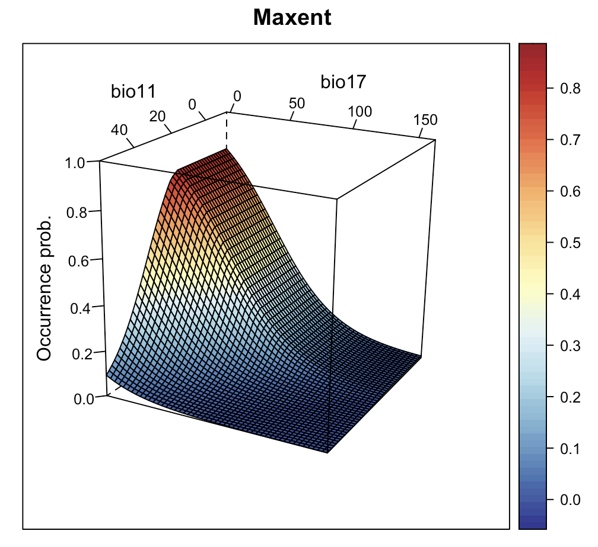
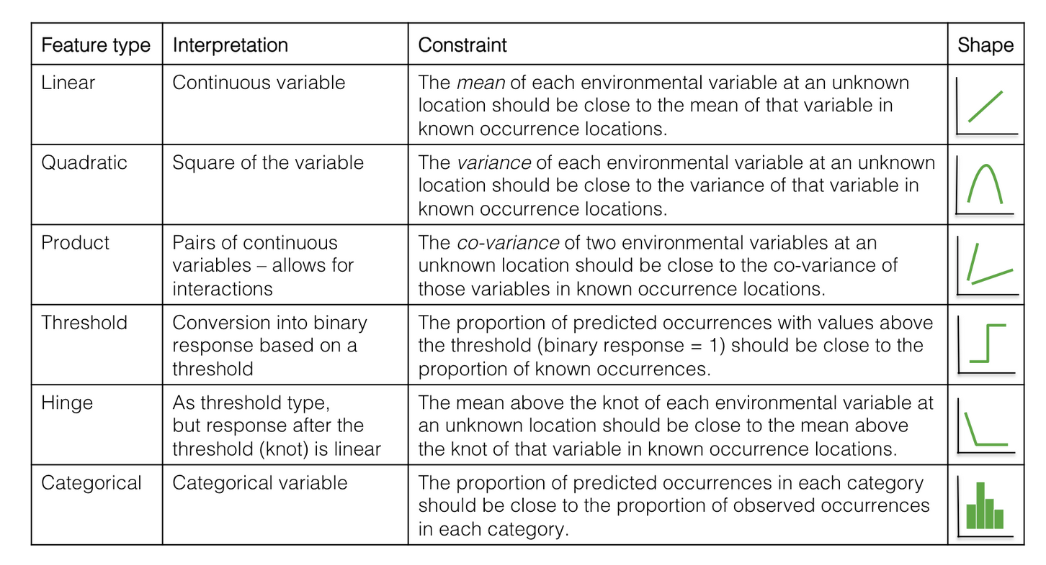
Presence / Background
Maxent
Maximum entropy approach
Maximizes similarity between env. distributions of background and presences
Parameters: Feature classes, regularization
Temperatura
https://support.bccvl.org.au/support/solutions/articles/6000083216-maxent
https://damariszurell.github.io/EEC-MGC/b6_SDM_algorithms.html
Notes:
Image credit: Left: Maxent. 2021. Biodiversity and Climate Change Virtual Laboratory. Available from: https://support.bccvl.org.au/support/solutions/articles/6000083216-maxent. Right: D. Zurell. 2022. SDM algorithms. Available from: https://damariszurell.github.io/EEC-MGC/b6_SDM_algorithms.html [CC BY 4.0].

Slide 25
Presence / Background
How does the environment associated with species' occurrences relate to the surrounding environment?
Background can contain presence points
Should be representative of the area the species can access (M)
Why/How is this different from:
Pseudoabsences?
Only presences?

Slide 26
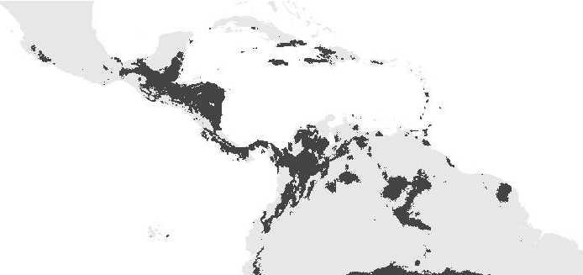
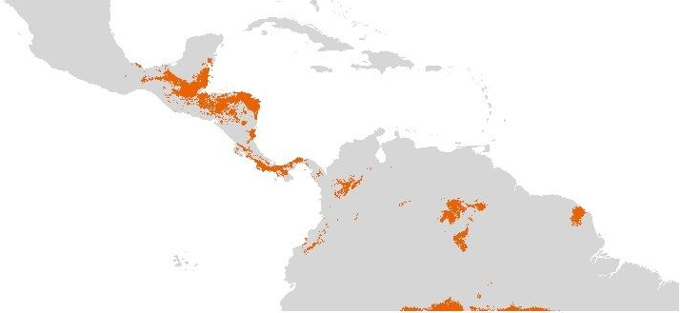
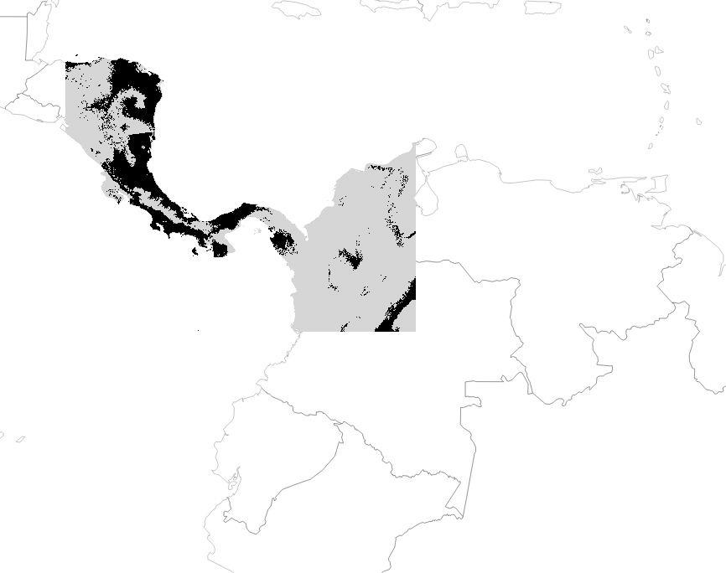
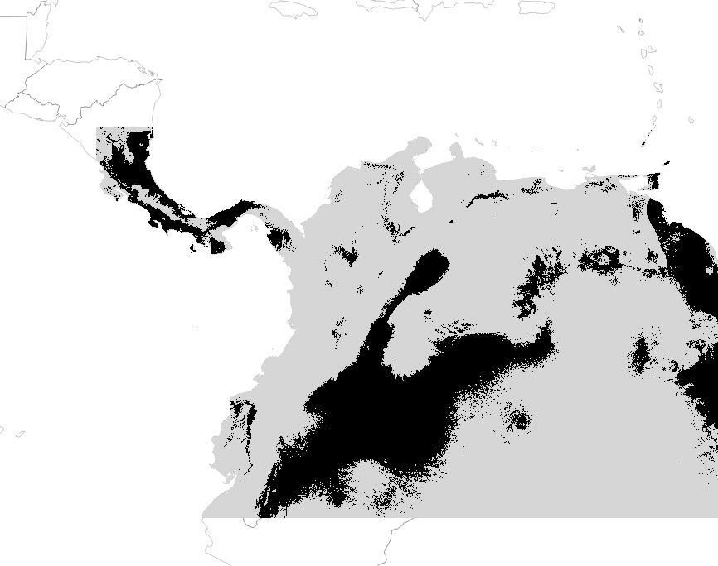
Projecting in time and space
It is possible to project models in time and space if the same variables are available. But should you?
Time
Training
Projection
Space
Notes:
Image credits: A. Paz.

Slide 27
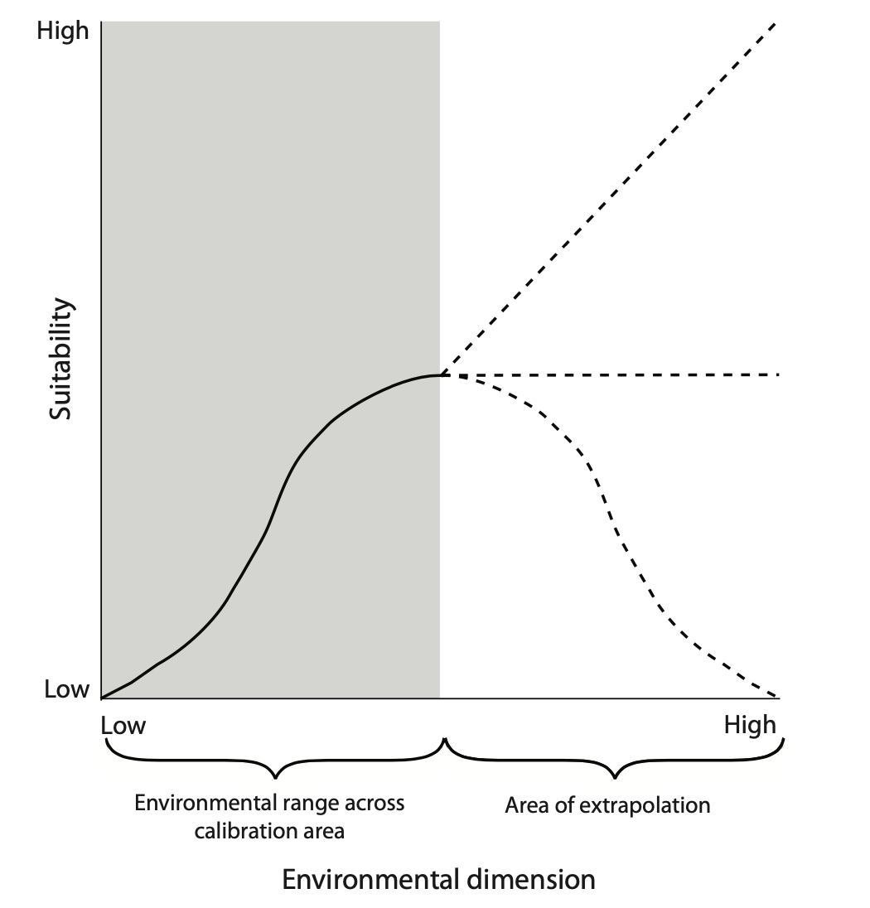
Projecting in time and space
The problem of extrapolation
Peterson et al., 2011
Notes:
Image credit: Peterson et al. 2011

Slide 28

Some things to take into consideration regardless of the algorithm
The accessible area M (study extent)
Point distribution
Temporal coverage of the points and variables
Collinearity of predictor variables
Use of thresholds

Slide 29
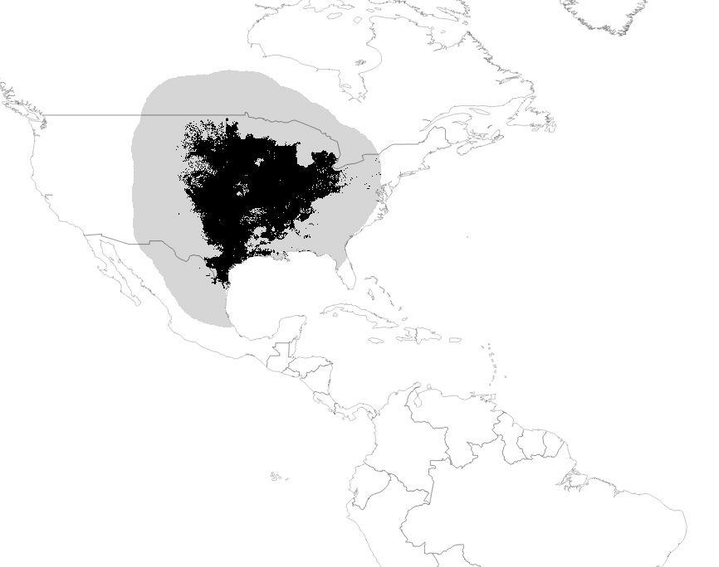
Some things to take into consideration regardless of the algorithm: Study extent
Study extent
Example modified from course materials by Peterson, Soberon & Martinez-Meyer, 2013
Notes:
Image credit: Modified by A. Paz from course materials by Peterson, Soberon & Martinez-Meyer, 2013.

Slide 30
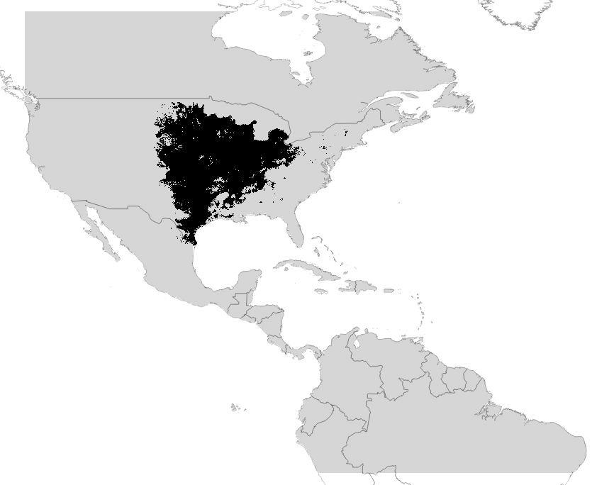
Some things to take into consideration regardless of the algorithm: Study extent
Study extent
Example modified from course materials by Peterson, Soberon & Martinez-Meyer, 2013
Notes:
Image credit: Modified by A. Paz from course materials by Peterson, Soberon & Martinez-Meyer, 2013.

Slide 31
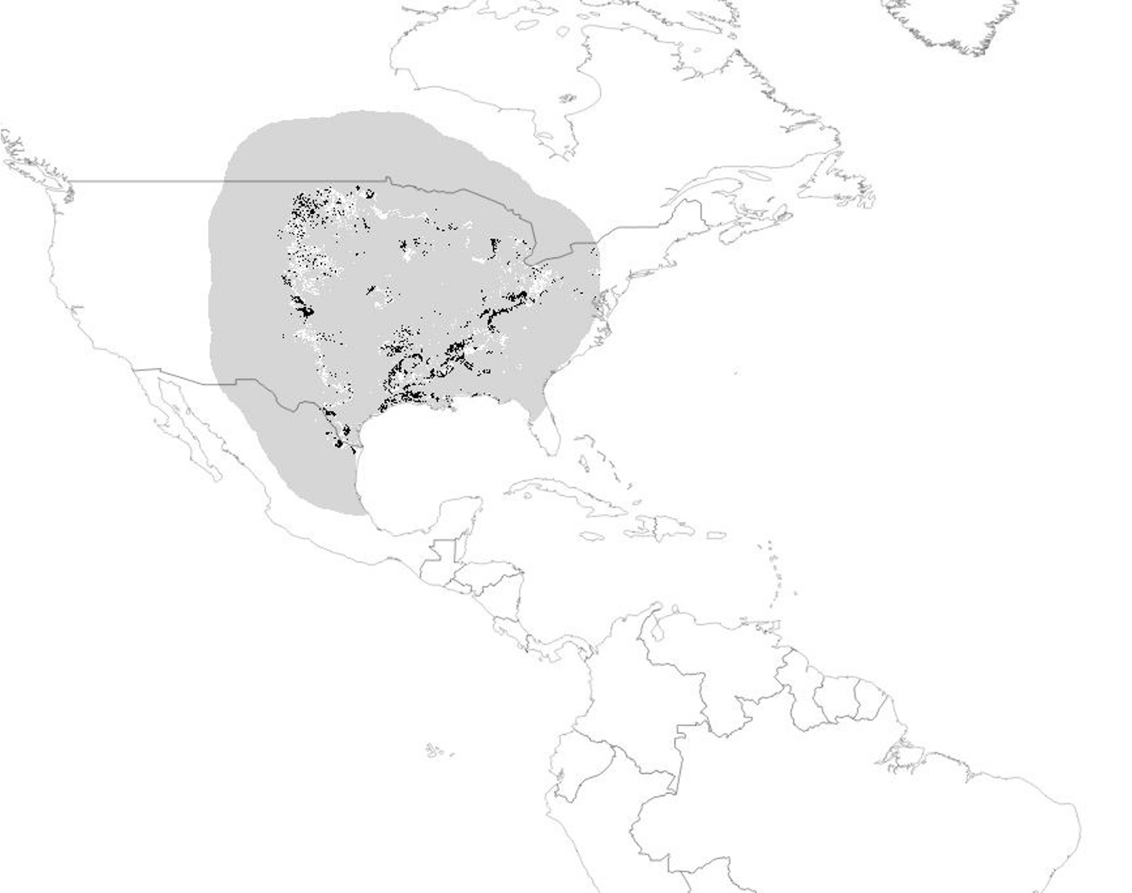
Some things to take into consideration regardless of the algorithm: Study extent
Grey: NO difference
White: Not predicted in the small extent
Black: Not predicted in the bigger extent
Example modified from course materials by Peterson, Soberon & Martinez-Meyer, 2013
Notes:
Image credit: Modified by A. Paz from course materials by Peterson, Soberon & Martinez-Meyer. 2013.

Slide 32
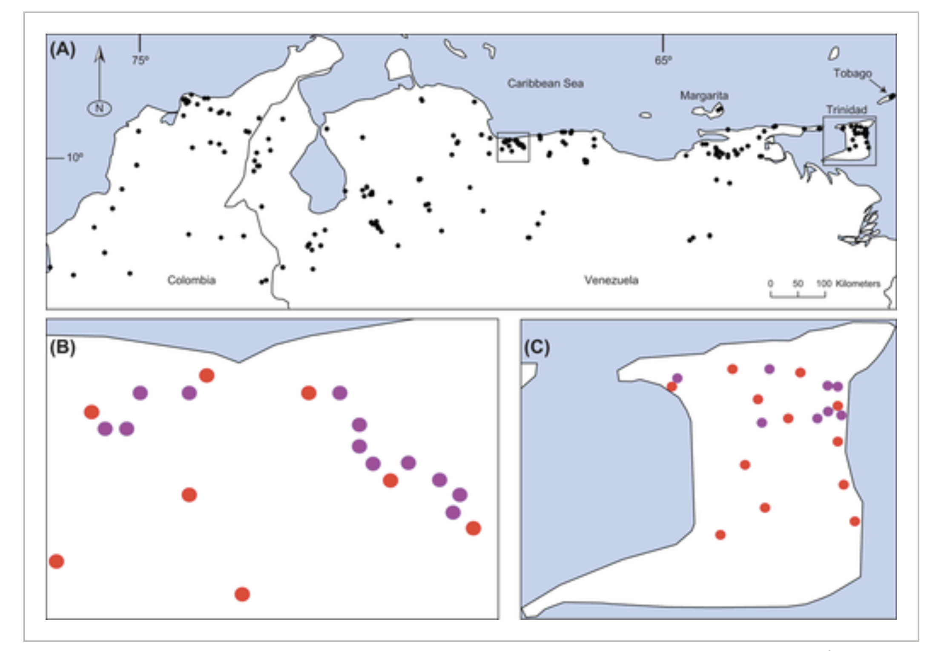
Some things to take into consideration regardless of the algorithm: Point distribution
Aiello-Lammens et al. 2015
Notes:
Image credit: Adapted from M.E. Aiello-Lammens, R.A. Boria, A. Radosavljevic, B. Vilela, and R.P. Anderson. 2015. spThin: an R package for spatial thinning of species occurrence records for use in ecological niche models. Ecography 38:541-545. https://doi.org/10.1111/ecog.01132.

Slide 33
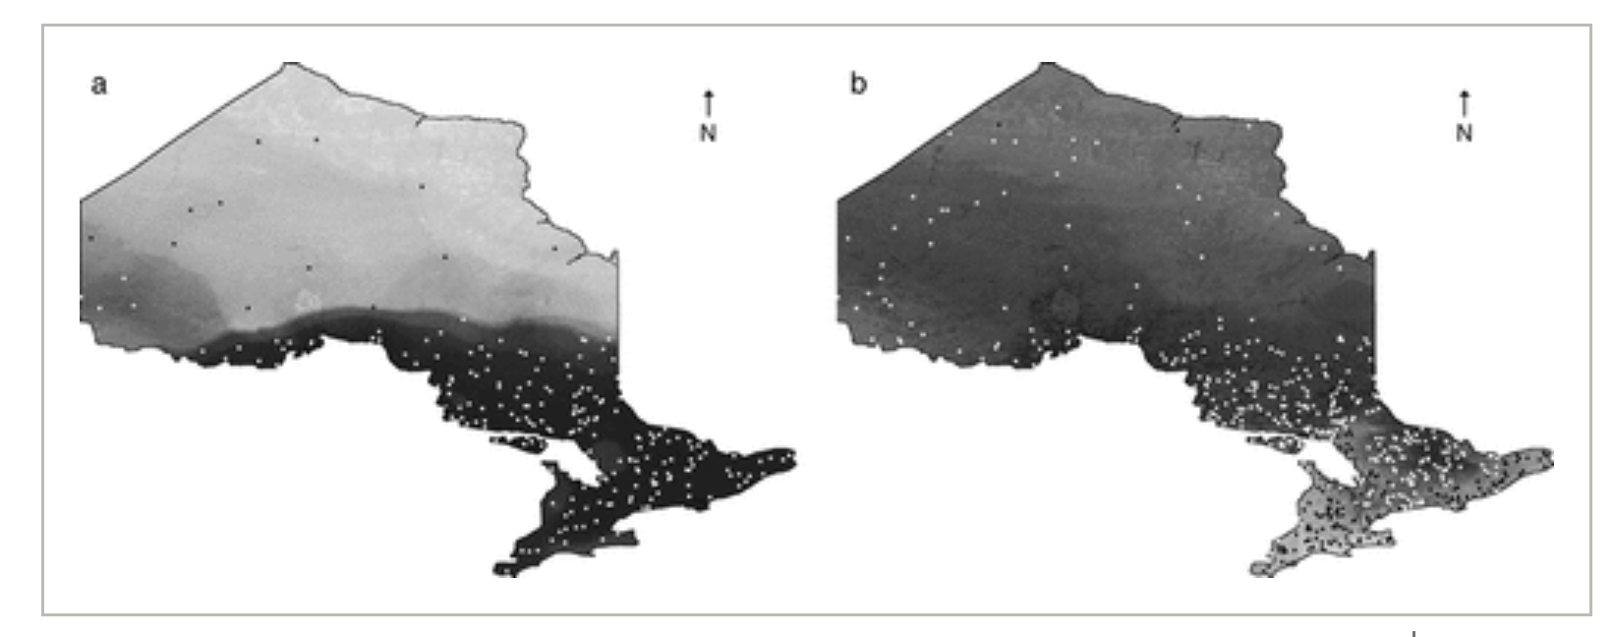
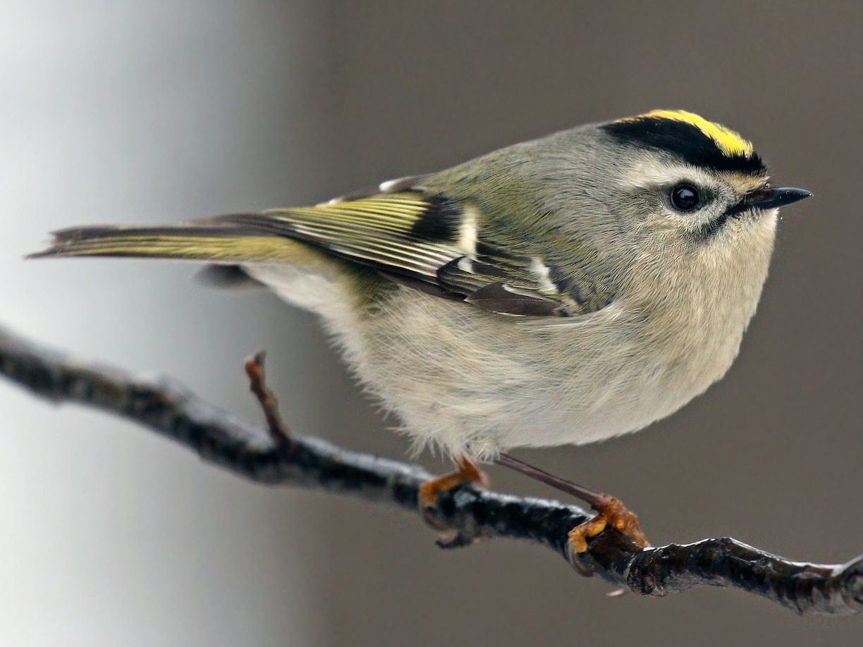
Some things to take into consideration regardless of the algorithm: Point distribution
Biased presence data
Biased presence + absence data
Golden-crowned kinglet
Phillips et al., 2009
Notes:
Image credit: Adapted from S.J. Phillips, M. Dudík, J. Elith, C.H. Graham, A. Lehmann, J. Leathwick, and S. Ferrier. 2009. Sample selection bias and presence-only distribution models: implications for background and pseudo-absence data. Ecological Applications 19:181-197. https://doi.org/10.1890/07-2153.1.
Image credit: Golden-crowned kinglet. Barbara Schelkle/ Wikimedia Commons [CC BY-SA 4.0}

Slide 34
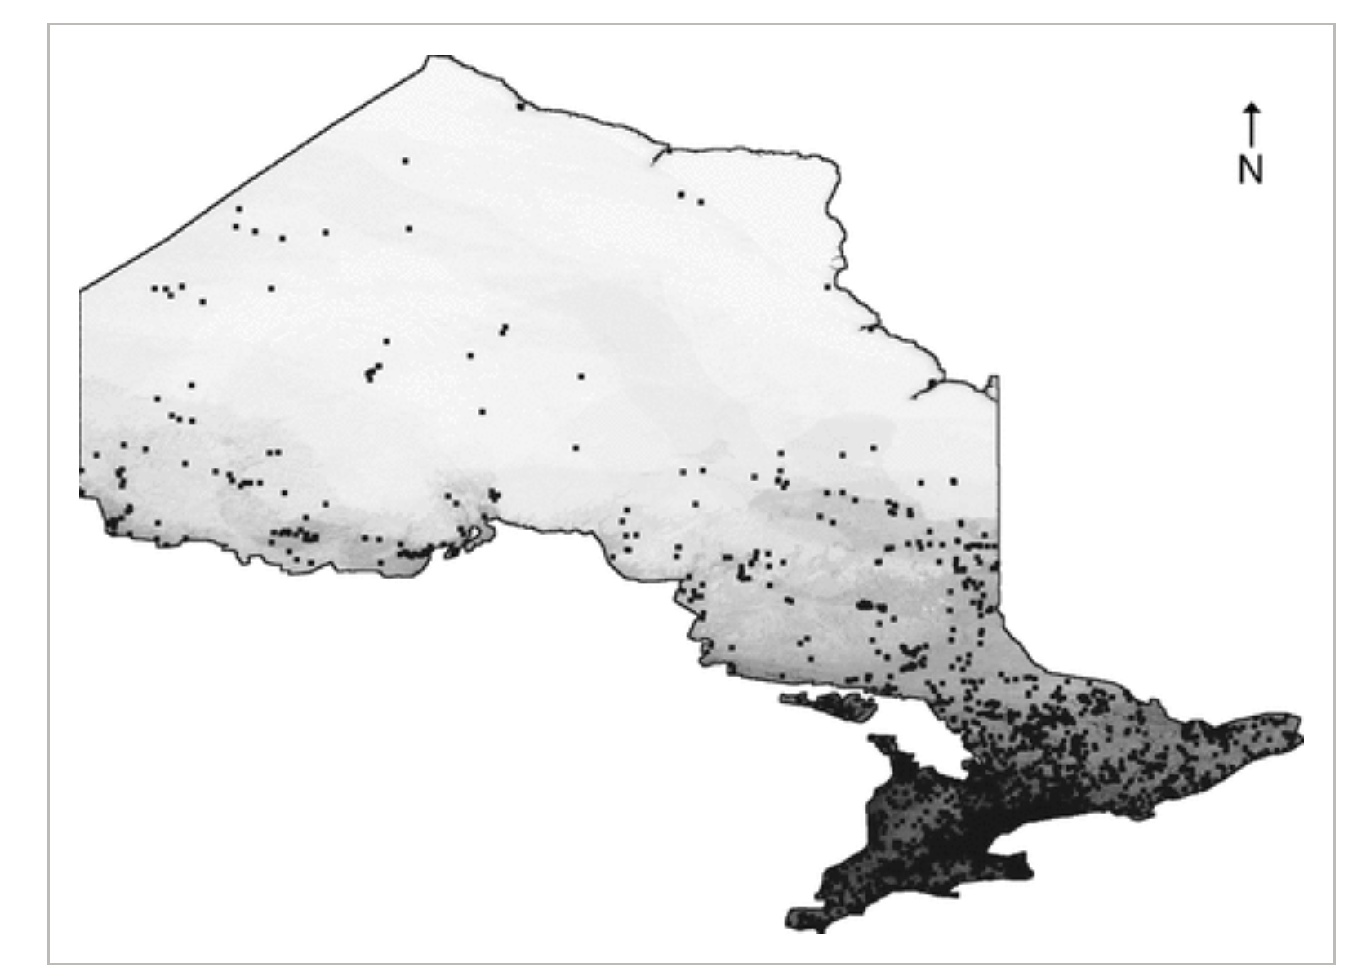
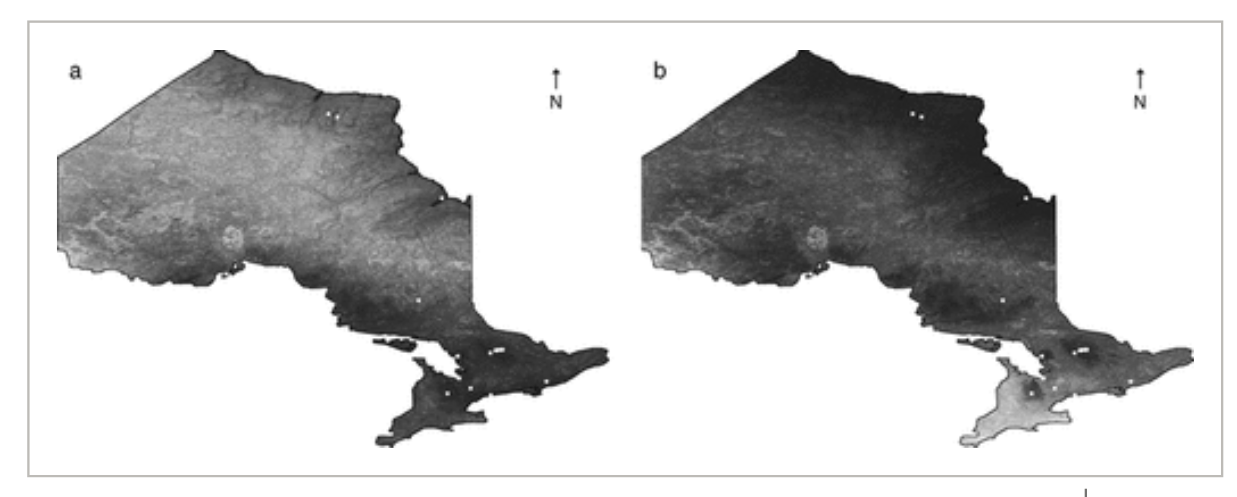
Some things to take into consideration regardless of the algorithm: Point distribution
Golden-crowned kinglet
Biased presence data
Target group background
Sampling density of all birds
Phillips et al., 2009
Notes:
Models created without and with target group background [target group being the sampling density for all birds in the province as shown in the upper right]. These models were built using Maxent.
Image credit: Adapted from S.J. Phillips, M. Dudík, J. Elith, C.H. Graham, A. Lehmann, J. Leathwick, and S. Ferrier. 2009. Sample selection bias and presence-only distribution models: implications for background and pseudo-absence data. Ecological Applications 19:181-197. https://doi.org/10.1890/07-2153.1.
Image credit: Golden-crowned kinglet. Barbara Schelkle/ Wikimedia Commons [CC BY-SA 4.0]

Slide 35
Some things to take into consideration regardless of the algorithm: Point distribution
Golden-crowned kinglet
Biased presence data
Target group background
Sampling density of all birds
Phillips et al., 2009
Notes:
Image credit: Adapted from S.J. Phillips, M. Dudík, J. Elith, C.H. Graham, A. Lehmann, J. Leathwick, and S. Ferrier. 2009. Sample selection bias and presence-only distribution models: implications for background and pseudo-absence data. Ecological Applications 19:181-197. https://doi.org/10.1890/07-2153.1.
Image credit: Golden-crowned kinglet. Barbara Schelkle/ Wikimedia Commons [CC BY-SA 4.0]

Slide 36
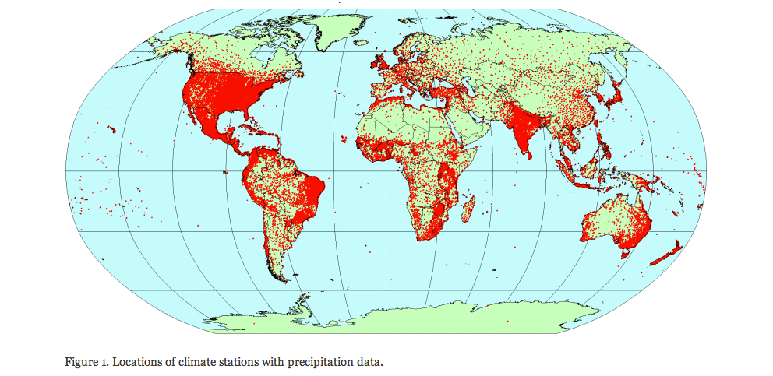
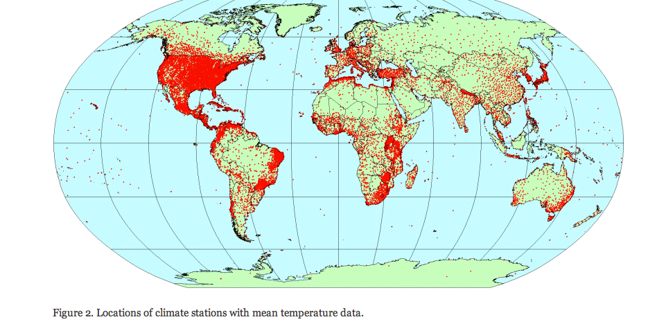
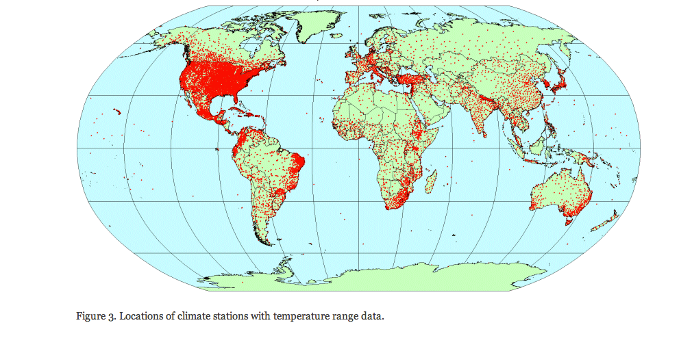
Some things to take into consideration regardless of the algorithm: About predictor variables: Worldclim
Stations with mean temperature data
Stations with precipitation data
1950-2000
Stations with temperature range data
Notes:
Image credit: Worldclim – Global Climate Data. Available from: https://www.worldclim.com/methods1.

Slide 37
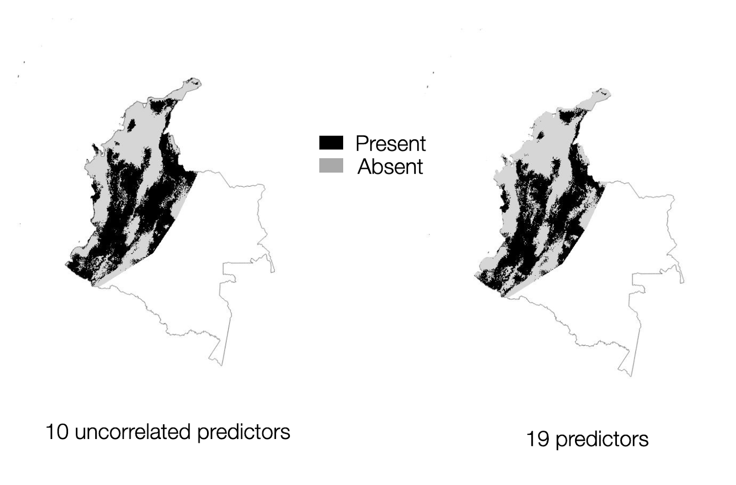
Some things to take into consideration regardless of the algorithm: variable correlation
Models built with one of 4 correlated variables
High consensus for present, but low consensus for future prediction
Present
Future
Model Consensus
Notes:
Using correlated variables for modelling might change present models slightly but more importantly will dramatically change future predictions. In this study areas in red are areas that were predicted by all variables. Areas in dark green by only one. So again some decisions matter most for some questions.
Image credit: A. Paz.

Slide 38
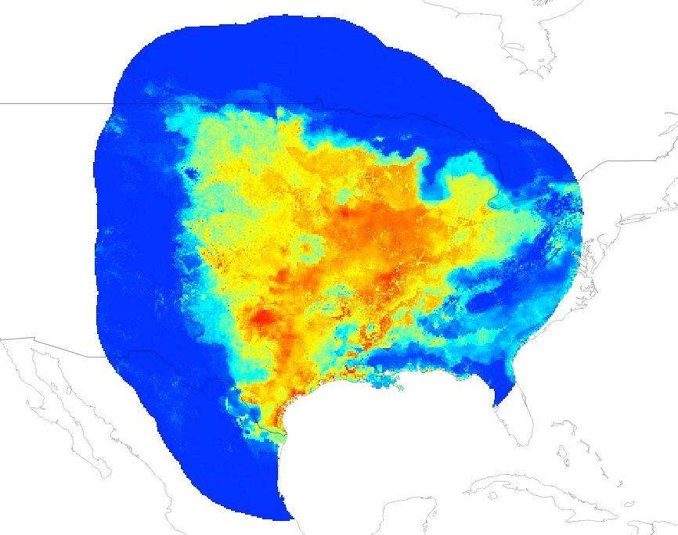
Some things to take into consideration regardless of the algorithm: thresholds
Thresholds and binary models
Example modified from course materials by Peterson, Soberon & Martinez-Meyer, 2013
Liu et al.2005
Pearson et al. 2006
Notes:
Image credit: Adapted by A. Paz from course materials by Peterson, Soberon, and Martinez-Meyer. 2013.

Slide 39
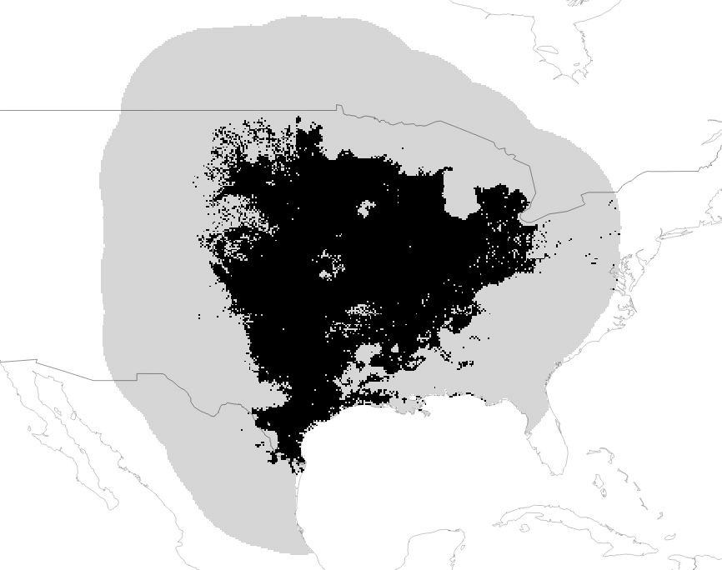
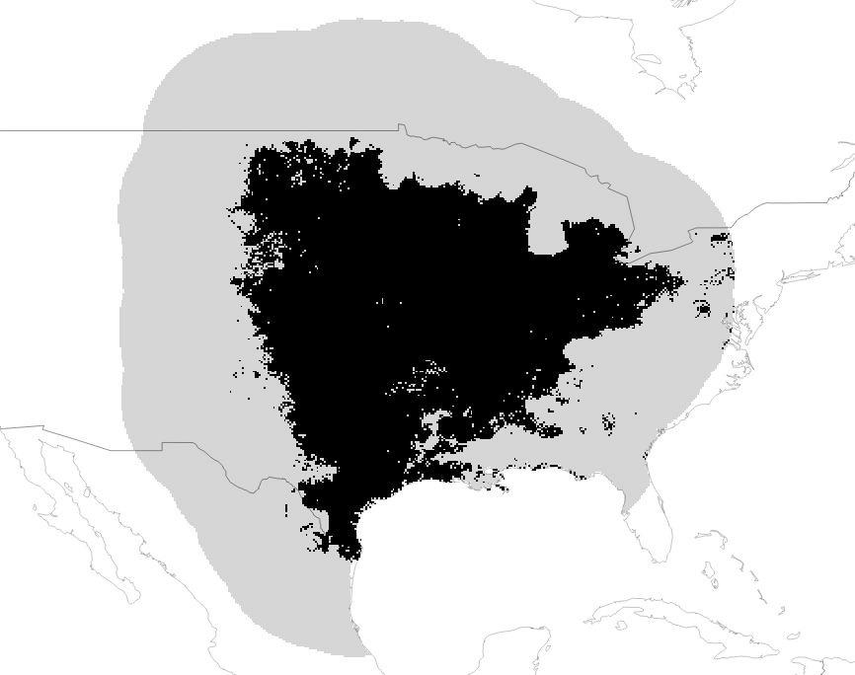
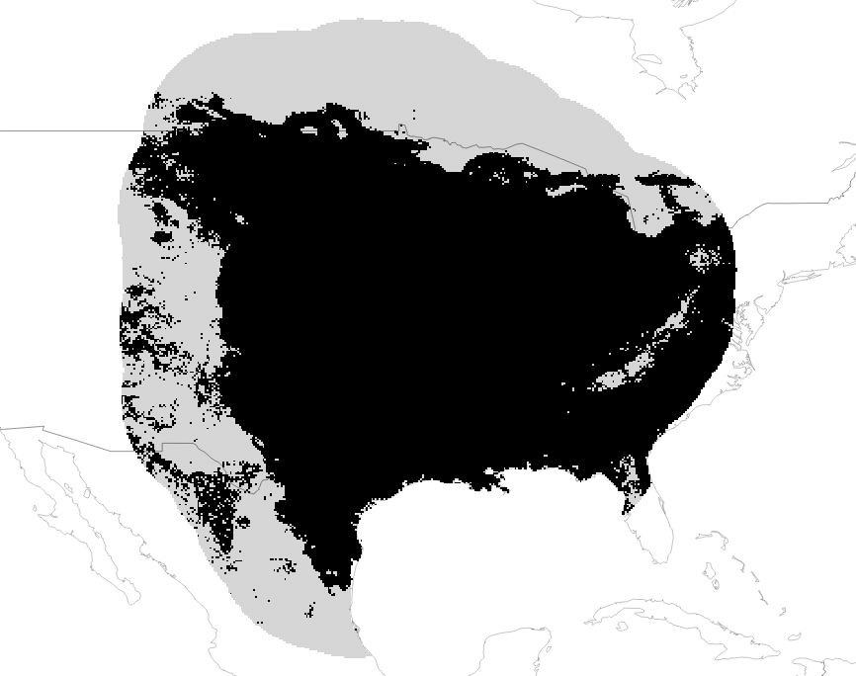
Some things to take into consideration regardless of the algorithm
Thresholds and binary models
Minimum training presence
10 percentile
Max Sensitivity + Specificity
Example modified from course materials by Peterson, Soberon & Martinez-Meyer, 2013
Notes:
Image credit: Adapted by A. Paz from course materials by Peterson, Soberon, and Martinez-Meyer. 2013.

Slide 40
“All models are wrong, but some are useful.”
- George E.P. Box

